Slide 1

iOS Dev Camp #3 Week 6 UIPageViewController
Edward Chiang
2014.11.10 - 2014.11.14

Slide 2

Today
UIPageViewController

Slide 3
UIPageViewController

Slide 4
Page View Controllers
You use a page view controller to present content in a page-by-page manner. A page view controller manages a self-contained view hierarchy. The parent view of this hierarchy is managed by the page view controller, and the child views are managed by the content view controllers that you provide.

Slide 5
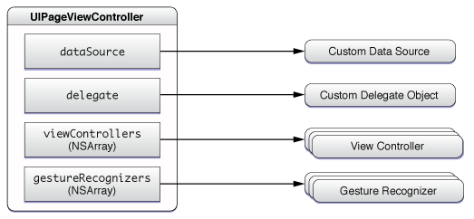
The Objects of PageViewController
An optional delegate
An optional data source
An array of the current view controllers
An array of gesture recognizers

Slide 6
Setting an Initial View Controller
Whether you create a page view controller in Interface Builder or programmatically, you need to set its initial view controllers before displaying it on the screen.
To set the initial view controller, call the setViewControllers:direction:animated:completion: method with an array containing the appropriate number of view controllers.

Slide 7
Customizing Behavior at Initialization
You pass parameter values and options to the initWithTransitionStyle:navigationOrientation:options: method to customize a page view controller when initializing it. They are accessible as read-only properties after initialization. You can customize:
The direction that navigation occurs: horizontally or vertically
The location of the spine: at either edge or in the center
The transition style: a page curl or scrolling

Slide 8
Data Source
The methods of the data source are called with the currently displayed view controller, and return the view controller that come before or after them. To simplify the process of finding the previous or next view controller, you can store additional information in your view controllers, such as a page number.

Slide 9
Right to left and bottom to top
To use a page view controller to display right-to-left or bottom-to-top content from a data source, just reverse the behavior of two methods:
In your data source, implement pageViewController:viewControllerBeforeViewController: to return the view controller after the given view controller.
In your data source, implement pageViewController:viewControllerAfterViewController: to return the view controller before the given view controller.
For right-to-left or top-to-bottom content, you typically want to set the spine location to UIPageViewControllerSpineLocationMax.

Slide 10
~ END ~
http://www.alphacamp.tw

